Slide 1


netEval - Network-Evaluation
Supervisor: Dr. Dan Ofir
Yehonatan Cohen & Carmel Ron

Slide 2
Introduction
Many advertisers are not sure when it’s the right time to advertise their services on a social network.
When advertisers want to advertise a product, they want to advertise it to a specific audience, for example, a product that is targeted to a certain gender.
The goal of the project is to develop a software which evaluates the worth of a social network and to analyze the information of the social network.

Slide 3
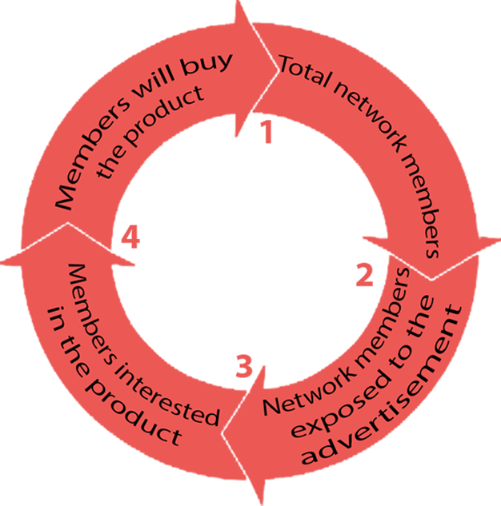
Evaluation algorithm
Loop over list of products
The algorithm simulates advertising process of a product on a network. Its purpose is to predict the number of people who are going to buy a product.
The algorithm evaluates the complexity of the network according to certain parameters such as network traffic, old data and random metrics.

Slide 4
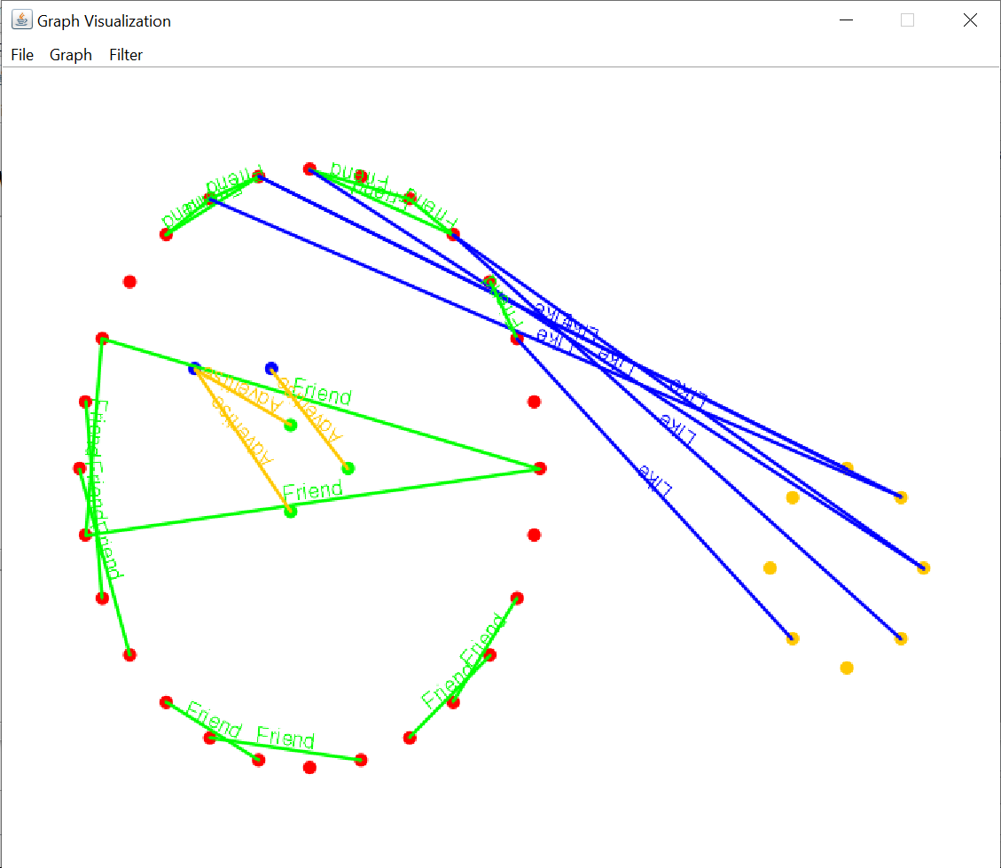
Network visualization
The software allows graphical presentation of the network according to groups and their connections and allows filtering according to the user's preference.
Each group is represented by a unique color and is linked to other groups according to the network data. By this the complexity of the network can be seen clearly and tangibly.

Slide 5
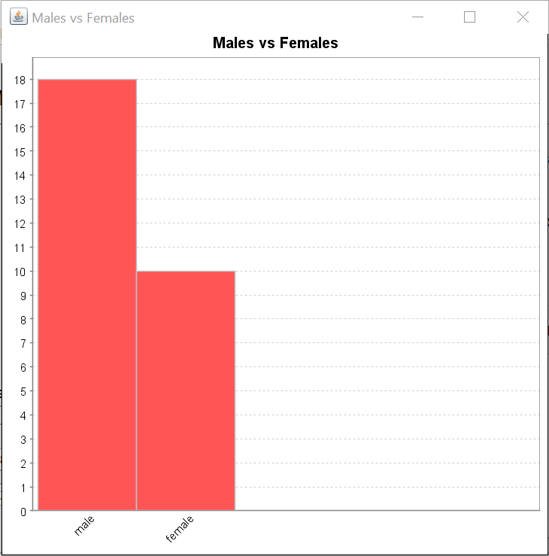
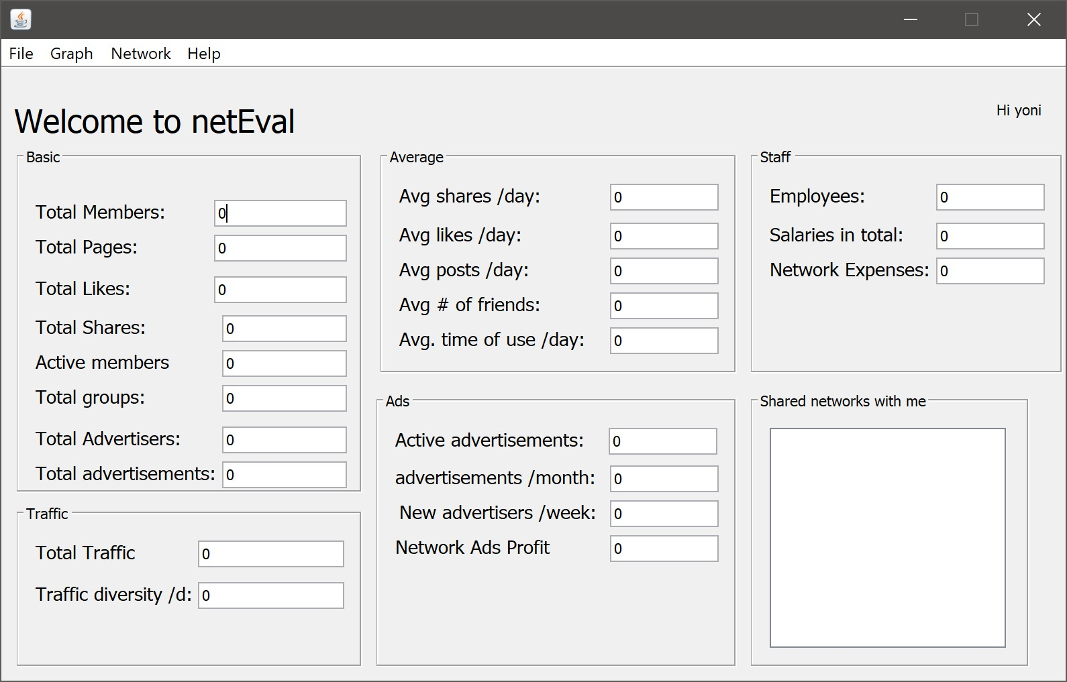
Data Analysis
The software allows to display information about the network through different distributions.
The software performs SQL queries on the database and collects data by using the jfreeChart library.

